Slide 1



SUPPORT BY RAKAMIN ACADEMY
Investigate
Hotel Business
USING DATA VISUALIZATION

Slide 2

SUPPORT BY RAKAMIN ACADEMY
About Me
Istifa has completed her studies and obtained a degree from Universitas Gadjah Mada. She has spent the last 7 months honing her skills in data management. She has gained experience in organizing and analyzing large datasets, creating visualizations and reports, and using statistical tools to draw insights. Her interest in both "manufacture" and "technology" has led her to pursue opportunities to apply her knowledge and skills in a wide range of industries. To further improve her skills in the field of data, She has completed several courses in data science boot camp, which has provided her with a deeper understanding of data analysis.
She is excited to continue developing her expertise in this dynamic field and contribute her knowledge to the growth of the company.

Slide 3


SUPPORT BY RAKAMIN ACADEMY
Case Study
Continuously evaluating business performance is crucial for any company, as it enables them to take appropriate actions to address any issues that arise. In this project, we will specifically examine the performance of the hotel industry by identifying customer behaviors related to hotel bookings and cancellations. Our primary objective is to analyze three factors: monthly hotel bookings by type, the impact of length of stay on hotel booking cancellations, and the impact of lead time on hotel booking cancellations. We will then visualize the insights gained from this analysis for easier comprehension.

Slide 4
DATA AND STEPS
Data Preprocessing
Prior to analyzing data, it is necessary to process it to enable insights to be derived. Additionally, raw data may contain inappropriate or missing values, making data processing essential. This time, the data processing stages will be implemented through the following approaches:
Addressing missing values.
Converting data types.
Addressing incorrect values (both categorical and numerical data).
LEARN MORE

Slide 5
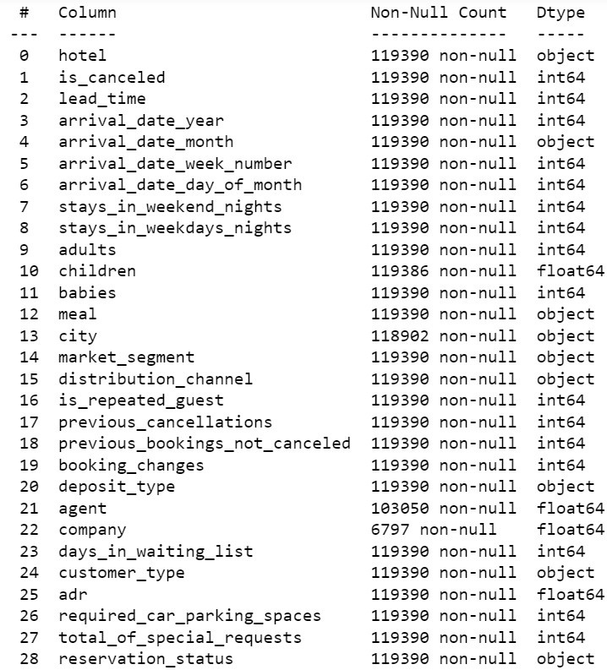
DATA PREPROCESSING
Handling missing values & change data type
The data on the side reveals that there are four columns or features that lack certain values, specifically the "company," "agent," "city," and "children" features. For the "company" and "agent" features, missing data should be filled with a value of 0 to indicate that the customer made the order without the help of an agent or company. The "city" feature should be filled with the value "unknown" as there is no clear information available. The "children" feature should be filled with a value of 0 assuming that the customer did not bring their child. Additionally, the data also involves some changes in data types in certain features, such as "children," "agents," and "company" features being transformed from float to integer, likely due to the fact that these values represent discrete counts or categories.

Slide 6
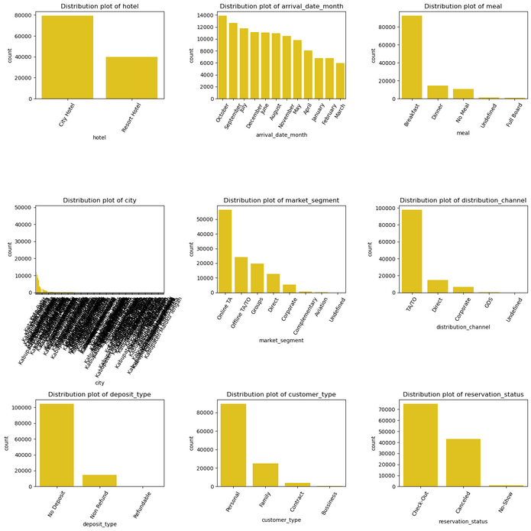
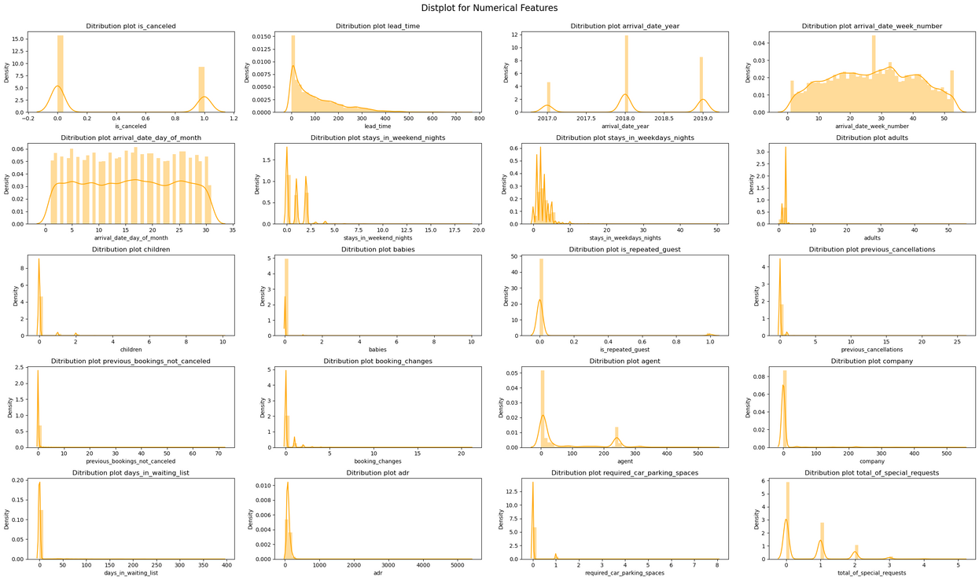
DATA PREPROCESSING
Handling incorrect values
Categorical data
Observed unsuitable values in both category and numeric data features.
a. Categorical Data
In categorical data, "market_segment", "distribution_channel", and "meal" features contain "undefined" values that require handling.
"Undefined" values in "market_segment" and "distribution_channel" will be replaced with the most common values: "Online TA" and "TA/TO", respectively.
"Undefined" values in the "meal" feature will be replaced with "No Meal" due to their similar meaning.
b. Numerical Data
Unnecessary data deletion is carried out on numerical data, specifically removing records with 0 guests and 0 nights.
To facilitate the deletion process, a new feature called "total_guests" is created by combining the "adults," "children," and "babies" features.
A new feature called "total_days" is also created by combining the "stays_in_weekend_nights" and "stays_in_weekday_nights" features.
The data with a "stay_duration" of 0 and "total_guests" of 0 are deleted.
Numerical data

Slide 7

DATA AND STEPS
Monthly Analysis of Hotel Bookings Segmented by Hotel Type
In the hospitality industry, customer behavior when booking hotels is crucial to increase income. Identifying popular hotel types and their seasonal demand is essential. To achieve this, we will compare monthly hotel bookings based on their types.

Slide 8
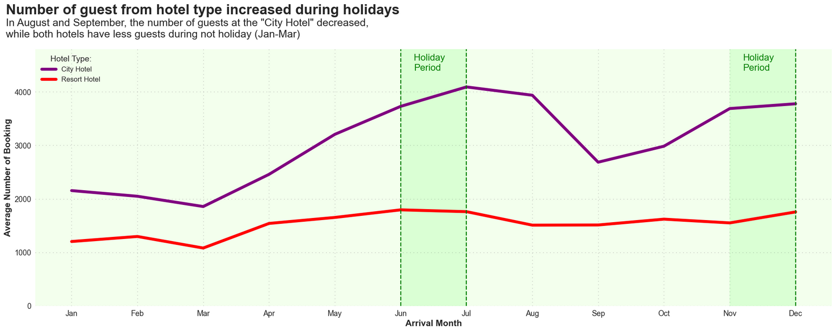
MONTHLY ANALYSIS OF BOOKINGS SEGMENTED BY HOTEL TYPE
Infographic About Booked
During the holiday period, both hotels experienced an increase in guests, with the "city hotel" having more visitors than the "resort hotel." In Indonesia, most schools have holidays from June to July, which is a time when families tend to travel together, explaining the rise in visitors during those months. This information can be useful in determining the timing of marketing implementation. However, from August to September, the "city hotel" experienced a significant decrease in the number of guests due to the school period. March had the lowest average number of bookings for both hotel types.

Slide 9

DATA AND STEPS
Analyzing the Influence of Length of Stay on Hotel Booking Cancellation Rates.
To evaluate the success of a hotel business, measuring the cancellation rate of bookings is crucial in addition to analyzing customer booking behavior. A high number of cancellations can negatively impact a hotel's performance. Thus, it is important to identify the factors that contribute to booking cancellations, including the length of stay. This analysis will examine the impact of the length of stay on hotel booking cancellation rates.

Slide 10
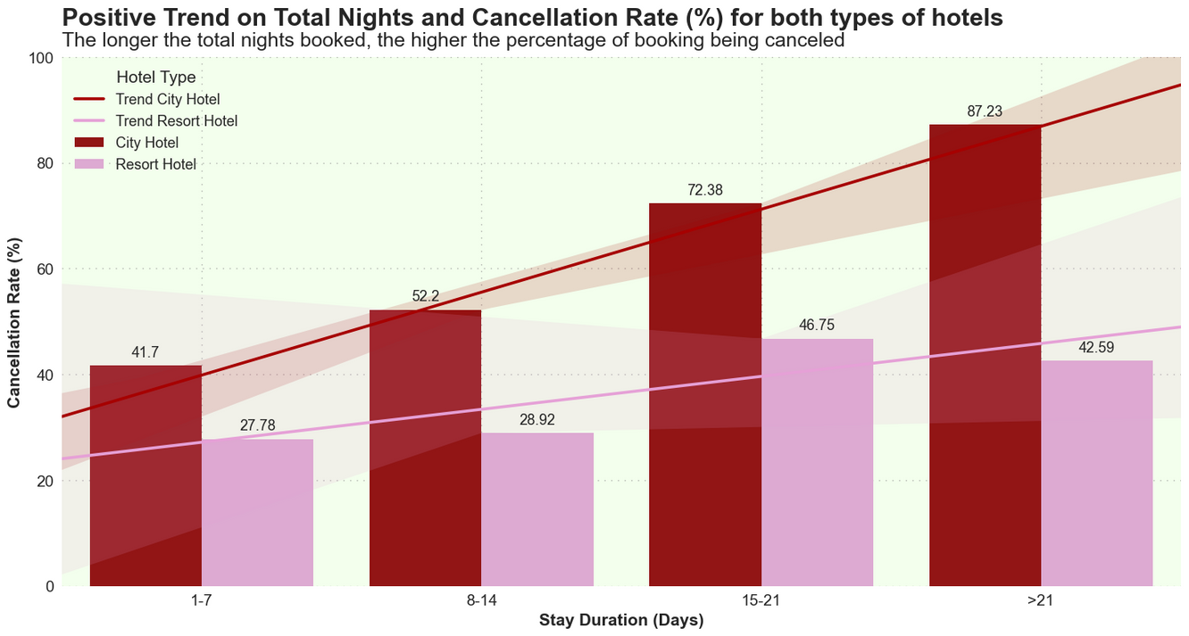
ANALYZING THE INFLUENCE OF LENGTH OF STAY ON HOTEL BOOKING CANCELLATION RATES
Infographic About Cancellation
The more nights booked, the more cancellations occur. "City hotels" have a higher rate than "resort hotels". The cancellation rate for "city hotels" is highest for stays over 21 days (87.23%) and for "resort hotels" it is highest for stays between 15-21 days (46.75%). To prevent this, hotels should have a cancellation policy where the cancellation fee increases with the length of stay.

Slide 11

DATA AND STEPS
Examining how the lead time influences hotel booking cancellations
The impact of the time gap between hotel bookings and the arrival date on the cancellation rate is being examined in this study, considering that hotels accept bookings well in advance, with varying time intervals ranging from a few days to several months.
LEARN MORE

Slide 12
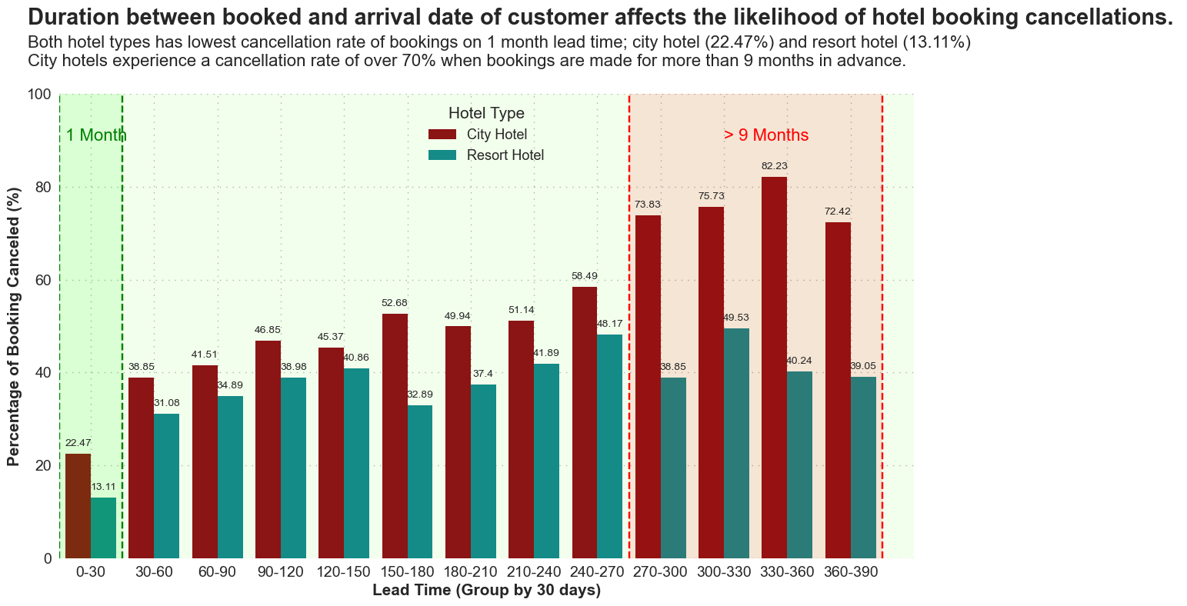
EXAMINING HOW THE LEAD TIME INFLUENCES HOTEL BOOKING CANCELLATION
Infographic About Cancellation
The more nights booked, the more cancellations occur. "City hotels" have a higher rate than "resort hotels". The cancellation rate for "city hotels" is highest for stays over 21 days (87.23%) and for "resort hotels" it is highest for stays between 15-21 days (46.75%). To prevent this, hotels should have a cancellation policy where the cancellation fee increases with the length of stay.

Slide 13

DATA AND STEPS
Business Insight
1
2
3
4
To reduce the cancellation rate, hospitality businesses can introduce a penalty system for cancelled hotel bookings.
A maximum booking lead time of three months can be implemented by the hospitality industry to reduce the cancellation rate.
A reminder system can be put in place, particularly for bookings made well in advance.
Hotels can offer marketing promotions or special services in peak seasons of June-July and November-December to attract more customers.

Slide 14

BY ISTIFA SHANIA
Thank You
CIAO

